Slide 1
Generative AI with Diffusion Models
Part 6: Wrap-up & Assessment

Slide 2
Agenda
• | Part 1: From U-Nets to Diffusion
• | Part 2: Denoising Diffusion Probabilistic Models
• | Part 3: Optimizations
• | Part 4: Classifier-Free Diffusion Guidance
• | Part 5: CLIP
• | Part 6: Wrap-up & Assessment
Notes:
Congratulations! We are now through all the hands-on practice labs and are ready for the assessment. Before we end the course let’s talk about how we can enhance what we’ve learned today in order to create state-of-the-art models.

Slide 3
Variational Autoencoders (VAE)
Notes:
Earlier, we talked about GANs, and this course focused on Diffusion Models. Variational Autoencoders are another type of popular generative AI architecture.

Slide 4

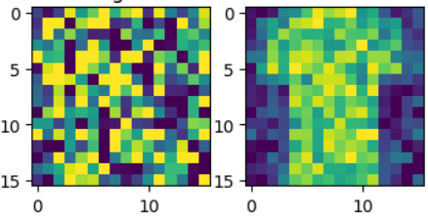

U-Net
Time
Position Embed
Time Embed 2
Feature Map
(Down0)
Down0
Copy
Feature Map
(Up2)
Time Embed 1
Context Embed 2
Feature Map
(Down1)
Down1 Copy
Feature Map
(Up1)
Context Embed 1
Feature Map
(Down2)
Down2 Copy
Feature Map
(Up0)
Latent Vector
Context
Notes:
Variational Autoencoders, or VAEs, use a neural network that is similar to a Diffusion Model. This is where we ended the diffusion course…

Slide 5
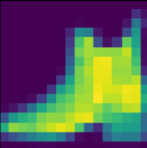
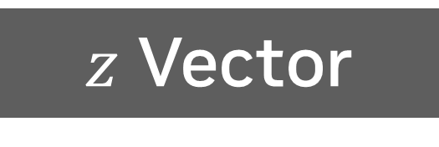
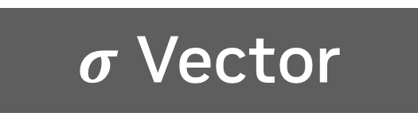
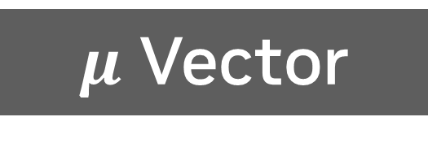
Variational Autoencoder
Feature Map
(Down0)
Encoder
Decoder
Feature Map
(Up2)
Context Embed 2
Feature Map
(Down1)
Feature Map
(Up1)
Context Embed 1
Feature Map
(Down2)
Feature Map
(Up0)
$μ$ Vector
Context
$z$ Vector
$σ$ Vector
Notes:
And this is what a VAE looks like. Looks cleaner and simpler, huh? If you were able to follow along with today’s class, you will have no problem picking up VAEs.
Like other kinds of Autoencoders, the model is split between an encoder and a decoder. Here’s what’s clever about this architecture. Like a U-Net, the bottom of the model flattens the feature map into a vector. However, VAEs have two vectors on the encoder side, and one vector on the decoder side. If we assume our latent vector follows a normal distribution, the encoder learns how to represent each value in the vector as a mean and a standard deviation.
Then when we decode the latent vector, we use the mean and standard deviation to calculate a z score. Conceptually, the model is learns how to represent image features as deviations from the feature average.

Slide 6
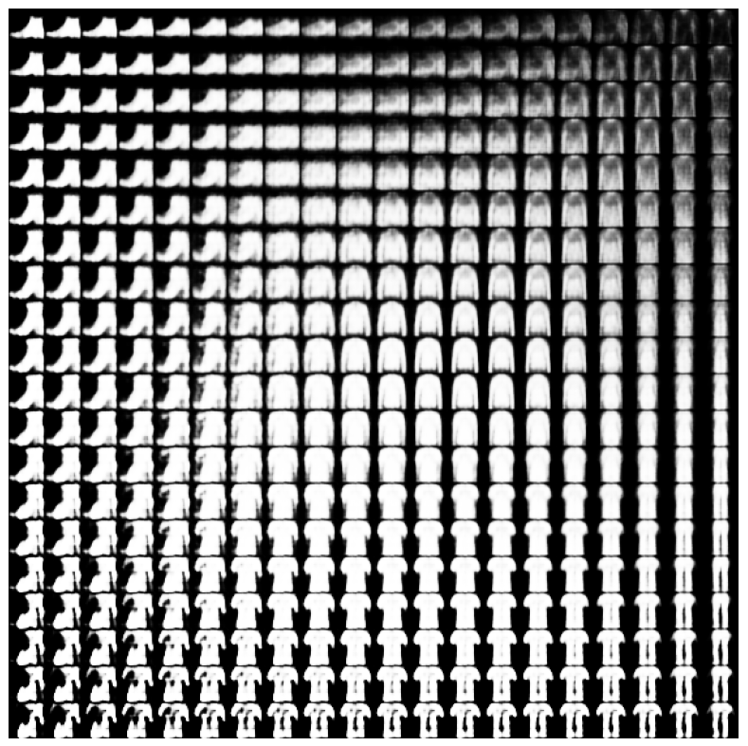
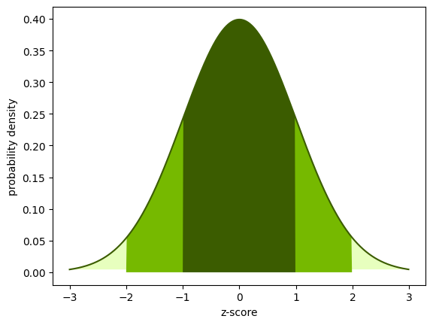
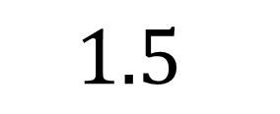
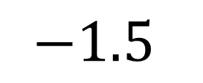
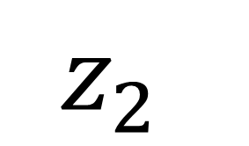
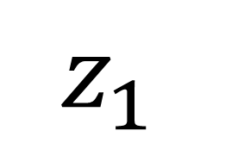
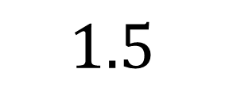
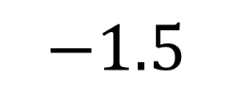
Variational Autoencoder
$$1.5$$
$$z_{2}$$
FashionMNIST
2 Latent Variables
$$−1.5$$
$$−1.5$$
$$z_{1}$$
$$1.5$$
Notes:
If we decide to represent our images with two latent variables, we can graph the result by plotting a range of different z scores. Here, we’ve trained a VAE on FashionMNIST. We can see how the model assigns different image features to the different values of z1 and z2. It’s amusing to see how a picture of a shirt is only a few steps away from a picture of pants.

Slide 7
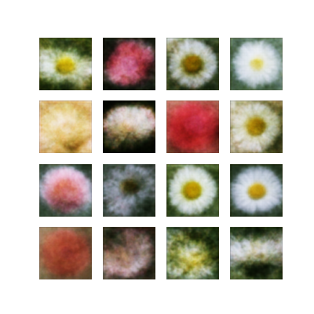
Variational Autoencoder
Modified TF Flowers
20 Latent Variables
16 Random Images
Notes:
The architecture for VAEs is clean and efficient compared to Diffusion models, but they do have a catch. Variational Autoencoders tend to produce blurry images. The theory is this is because the model is learning to represent image feature averages.

Slide 8
State of the Art Models
Notes:
We’ve now covered many of the basic components of Generative AI models. Let’s see where we can go from here?

Slide 9
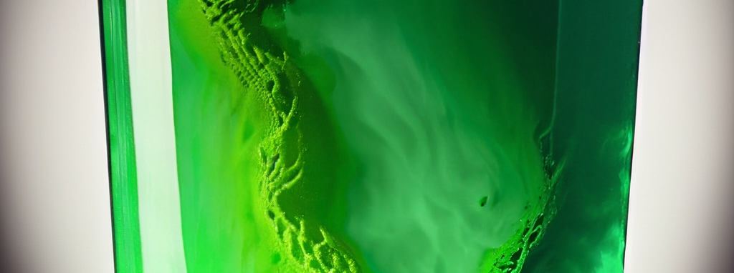
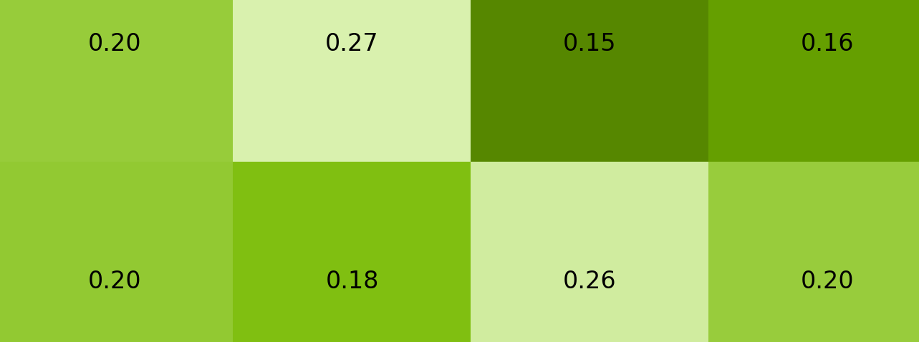
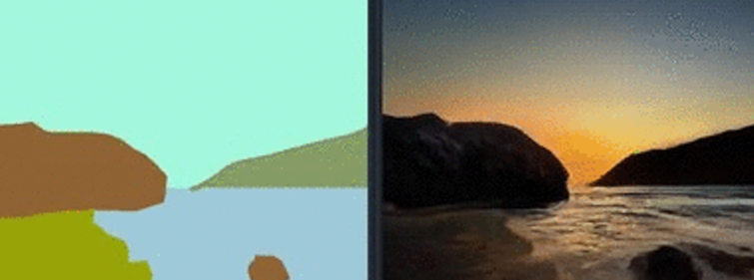
State of the Art Models
All of them are used
Diffusion
VAE
CLIP
GAN
Notes:
Here are four of the model architectures we learned today. Which one do you think is used by state of the art models?
Sorry, it’s a trick question. State of the art models use a combination of all of these.

Slide 10
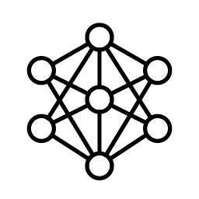


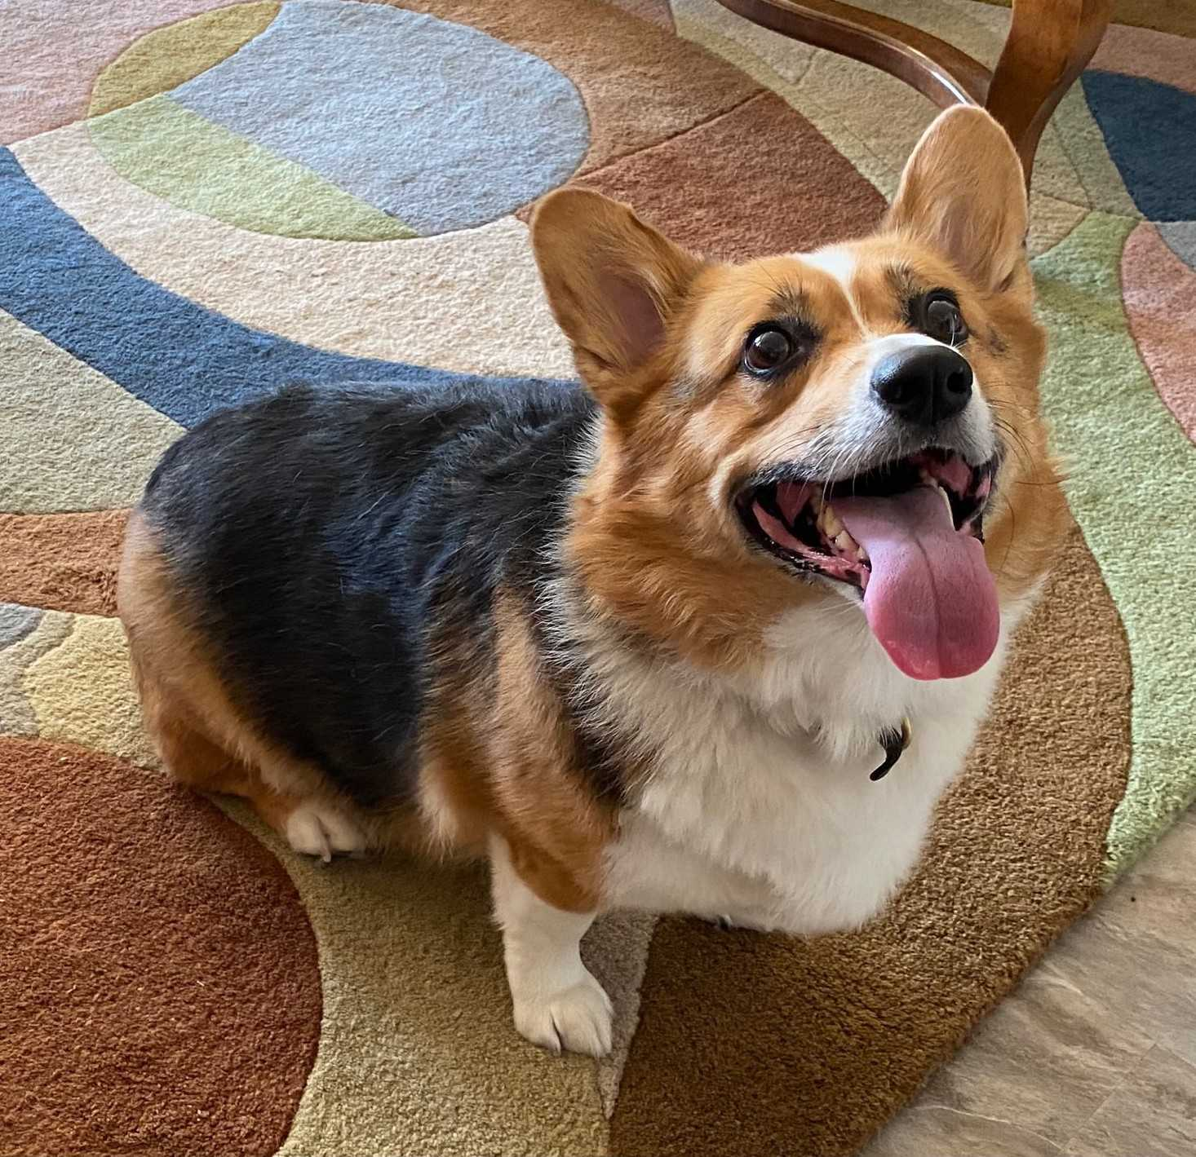
Latent Diffusion
VAE
Diffusion
Encode Image
Latent Diffusion
Decode Image
Notes:
Let’s look at one example of a popular State-of-the-art model: latent diffusion. We could make a VAE that learns how to generate an image based on a segmented image. Then, instead of using diffusion to denoise an image, we can denoise a latent vector. Trippy to think about, isn’t it?

Slide 11
Tiled Upsampling
Transposed Convolution Review
Kernel
Image
Output
.25 | 0 | 0 | .25
0 | .25 | .25 | 0
0 | .25 | .25 | 0
.25 | 0 | 0 | .25
.25 | .25
.25 | .25
1 | 0 | 1
0 | 1 | 0
1 | 0 | 1
Notes:
Here’s another popular combination of models. As we saw, diffusion takes a while to generate even relatively small images. What if we keep the images produced by diffusion small, and then created another model just to upsample the image?
Here we have a typical convolution kernel.

Slide 12
Tiled Upsampling
Convolving with a Neural Network
Kernel?
Image
Output
? | ? | ? | ?
? | ? | ? | ?
? | ? | ? | ?
? | ? | ? | ?
1 | 0 | 1
0 | 1 | 0
1 | 0 | 1
Notes:
We could replace the convolution kernel with another neural network, with values that change based on what is in the convolution window. Some models create another diffusion model purely for upsampling. Others use a VAE.

Slide 13
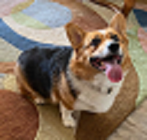
Tiled Upsampling
Convolving with a Neural Network
Kernel?
Image
Output
Notes:
Remember at the beginning of the course when we talked about upsampling, and the results with traditional techniques were blurry? Neural networks are great at producing nice sharp images.

Slide 14
Trustworthy AI
Notes:
On the subject of state-of-the-art models, let’s talk about Trustworthy AI.

Slide 15




Foundations of Trustworthiness
Laws & Regulations
An AI model complies with relevant laws, regulations, and standards for the region and industry where it is deployed
Accountability
Responsibility
Accountability means being answerable for the impact of an AI on the societal system that uses it and being thoughtful about how it might be misused
Certification
Trustworthy AI Principles
Responsibility can be legal or moral. Legal responsibility requires a violation of a law or regulation. Moral responsibility occurs from an action or an intentional failure to act.
An AI model has been certified as fit for purpose as required by the region or industry where it is deployed
Notes:
Trustworthy AI sits at the intersection of many factors.
Accountability and Responsibility are two semi-external factors that developers have some control over.
Laws & Regulations and certifications are external factors that developers have no control over, but influence how models should be developed.
Accountability means being answerable for the impact of an AI on the societal system that uses it and being thoughtful about how it might be misused
Responsibility can be legal or moral. Legal responsibility requires a violation of a law or regulation. Moral responsibility occurs from an action or an intentional failure to act.
As for Laws & Regulations, an AI model must comply with relevant laws, regulations, and standards for the region and industry where it is deployed
And for Certification, n AI model has to be certified as fit for purpose as required by the region or industry where it is deployed

Slide 16
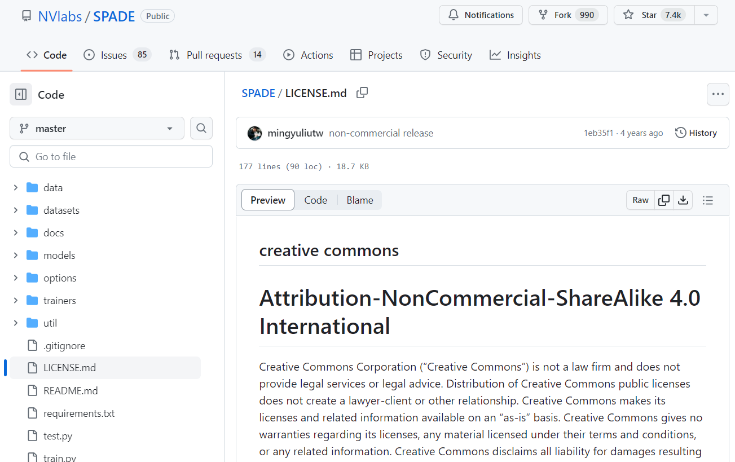
Check the License
Many code repositories and datasets have a license file which describe the use limitations such as:
Whether the asset can be used for commercial purposes
How the authors would like to be recognized or attributed
Notes:
It is certainly challenging navigation the legal landscape. For every dataset or model that DLI uses, the first thing we look for is the license file. These files will often explicitly state if the asset can be used commercially or non-commercially, and how the author wishes to be recognized.

Slide 17
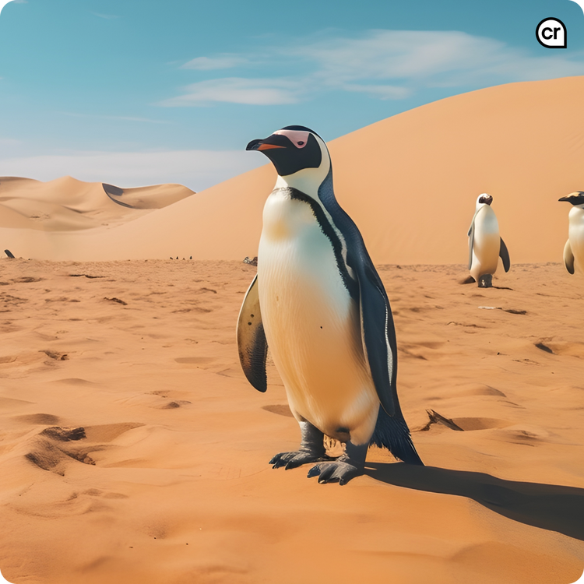

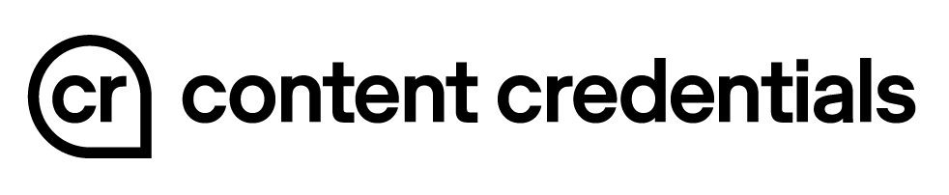
Trustworthy AI Tools
Notes:
The Content Authenticity Initiative, or CAI, is making tools for content creators to share their work while getting recognized. If you see a picture like this online…

Slide 18
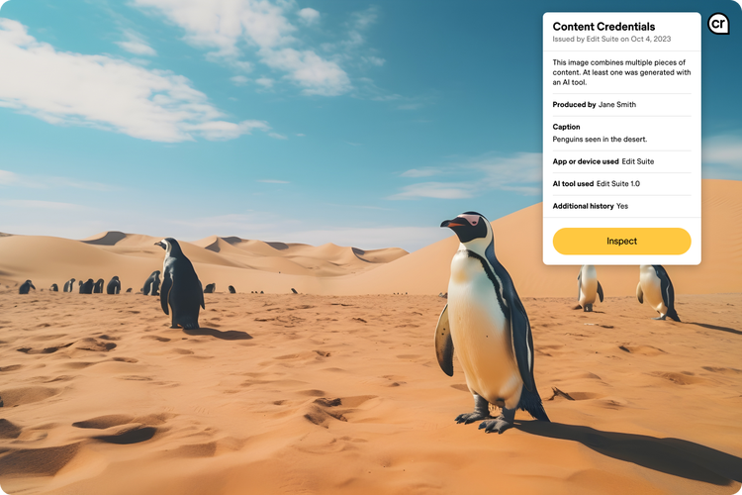
Trustworthy AI Tools
Notes:
You can hover your mouse over the content credentials logo to see who created the content and how.

Slide 19
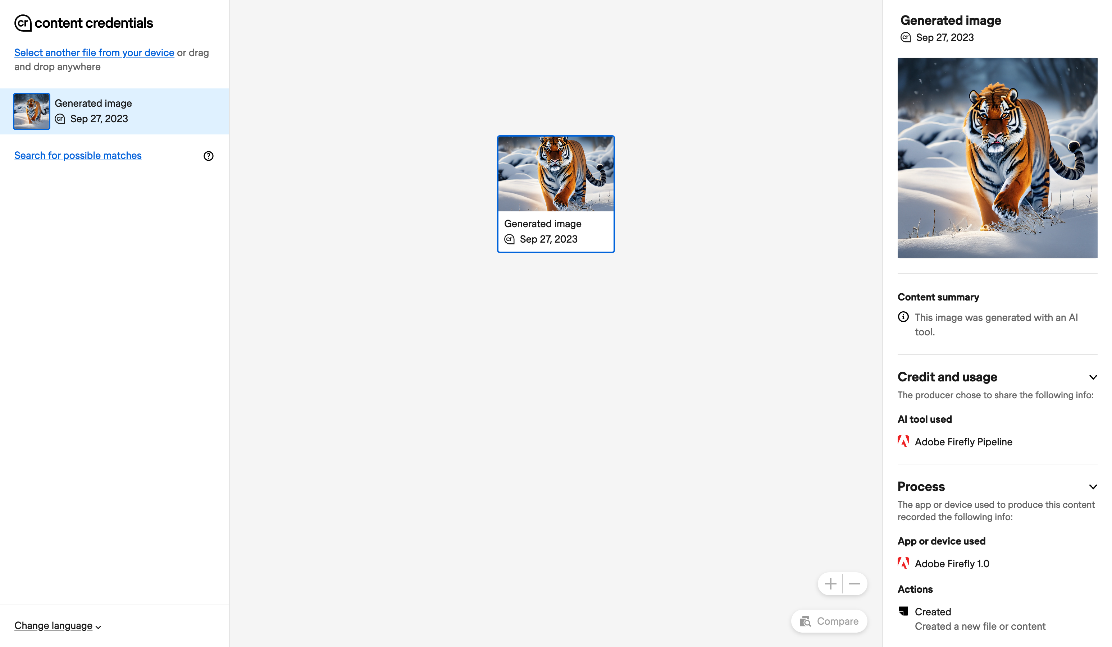
All content generated with Adobe Firefly is clearly labeled and can be inspected
Notes:
If you generate an image with Adobe Firefly, it automatically includes content credentials that can be inspected.

Slide 20
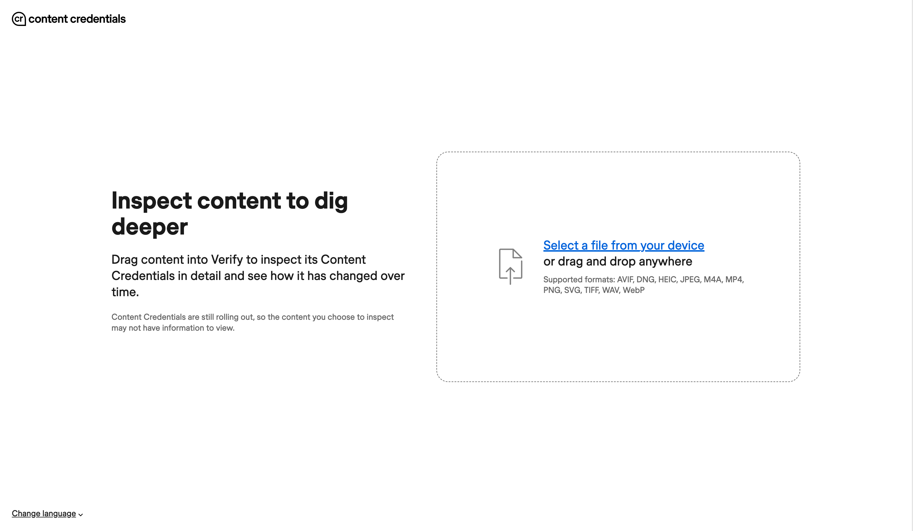
Notes:
We’ve included a link to this resource in the instructor notes. Try generating an image with Adobe Firefly and uploading it here.
https://contentcredentials.org/verify

Slide 21

The Verify inspection tool allows us see the provenance of a digital file
Notes:
For images created from multiple sources, this view will show the file history and how it has changed.

Slide 22
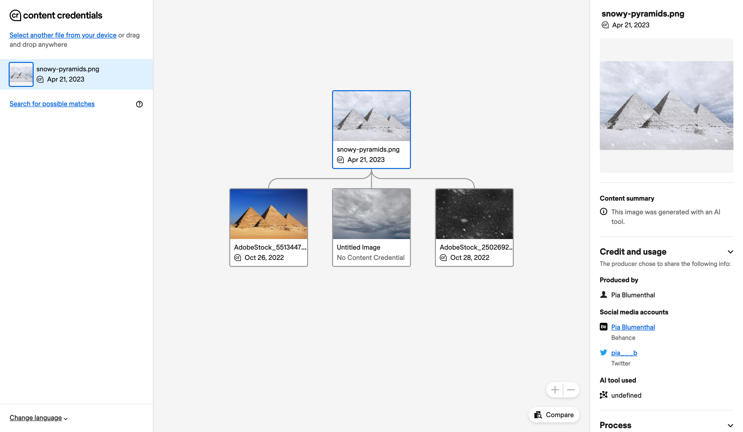
Notes:
For instance, these snowy pyramids were created by combining multiple photos. The Content Credentials tool can display that history in a tree.

Slide 23

The Content Credentials pin will appear next to content online, indicating that provenance information is present.
Notes:
Anywhere you see this logo, check it out to see the story behind the content.

Slide 24
Adobe Firefly
Notes:
One of the reasons we chose to highlight Adobe Firefly throughout this course is because they have worked extensively to be fair to content creators in this new generative AI world. Adobe Firefly was trained on Adobe’s own licensed stock images, other works in the public domain, moderated generative AI content, and work that is openly licensed by the rightsholder.

Slide 25
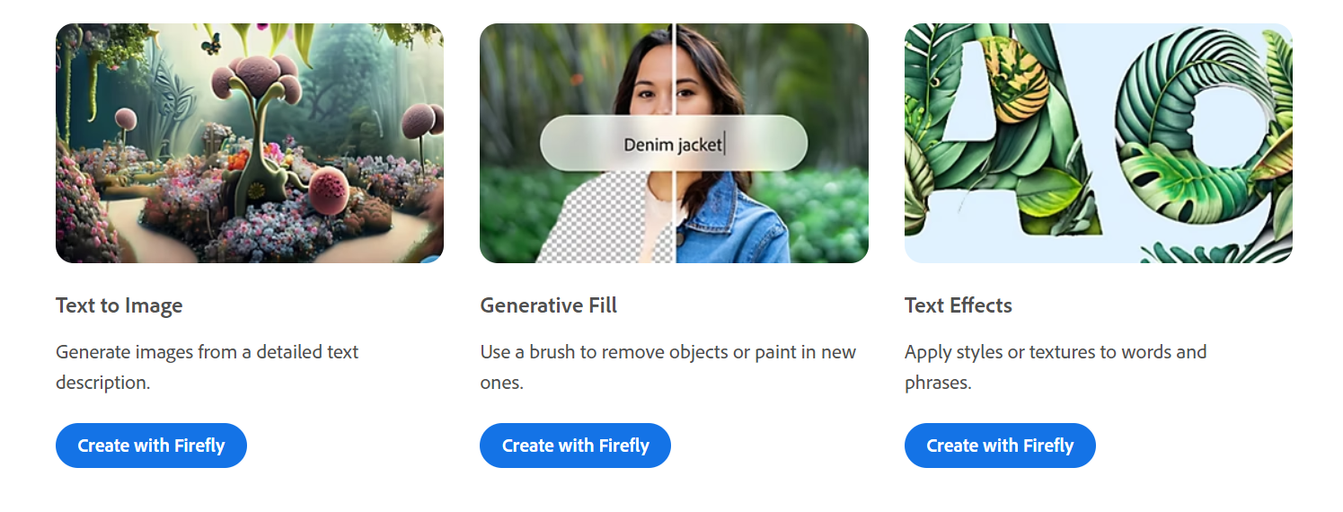
Adobe Firefly
https://firefly.adobe.com/
Notes:
And all that hard work has paid off! I had a blast using Firefly to make this course. If you create an account with Adobe, you can try the same tool for free.

Slide 26
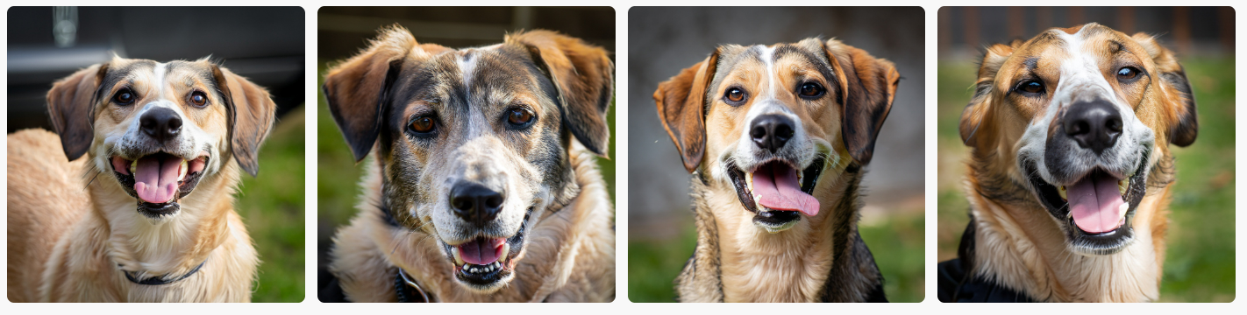
Prompt Engineering
State-of-the-art Models
Better understanding the vocabulary the model was trained will make it easier to influence the results.
“Portrait of a happy canine with a 300mm lens”
“Portrait of a happy canine with a 17mm lens”
Notes:
Like any other generative AI model, it takes a little practice to get the most out of it. Firefly images already look great with basic prompts, but being more descriptive adds more control. Take these wonderful canines for example. If I specify what kind of camera lens the photo was taken with, there will be a slight change in the output.

Slide 27
Good Luck!
Notes:
That’s all folks, now its your time to shine! Good luck on the assessment. If you made it this far, you can reach the end!

Slide 28
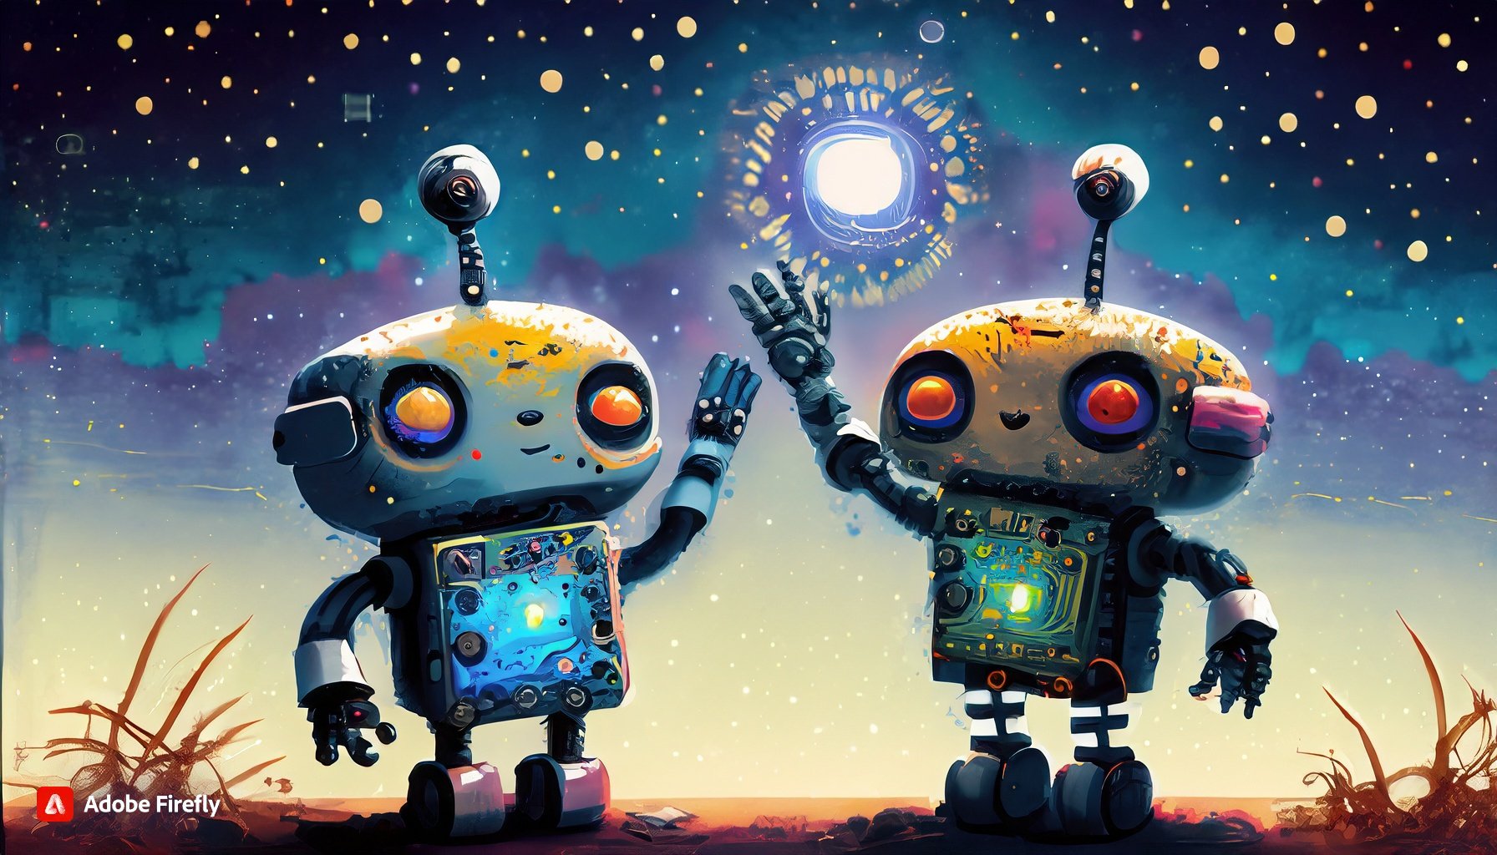
Two cute robots that look like computer boards waving goodbye under a starry sky

